Slide 1



Noida Institute of Engineering and Technology, Greater Noida
Customer Relationship Management (AOE0865)
Unit: 2
Managing Customer Acquisition and Customer Loyalty
(AOE0865)
Ms. Rachna Sharma
CSE(DS)Department
B Tech 8th Sem

Slide 2
Noida Institute of Engineering and Technology, Greater Noida
Managing Customer Acquisition
Customer Lifetime Value (CLV)
Definition: The total value a customer generates during their relationship with a business.
Importance:
Helps in allocating resources efficiently.
Identifies high-value customer segments.
Calculation: CLV=Average Purchase Value×Purchase Frequency×Customer LifespanCLV = \text{Average Purchase Value} \times \text{Purchase Frequency} \times \text{Customer Lifespan}CLV=Average Purchase Value×Purchase Frequency×Customer Lifespan

Slide 3
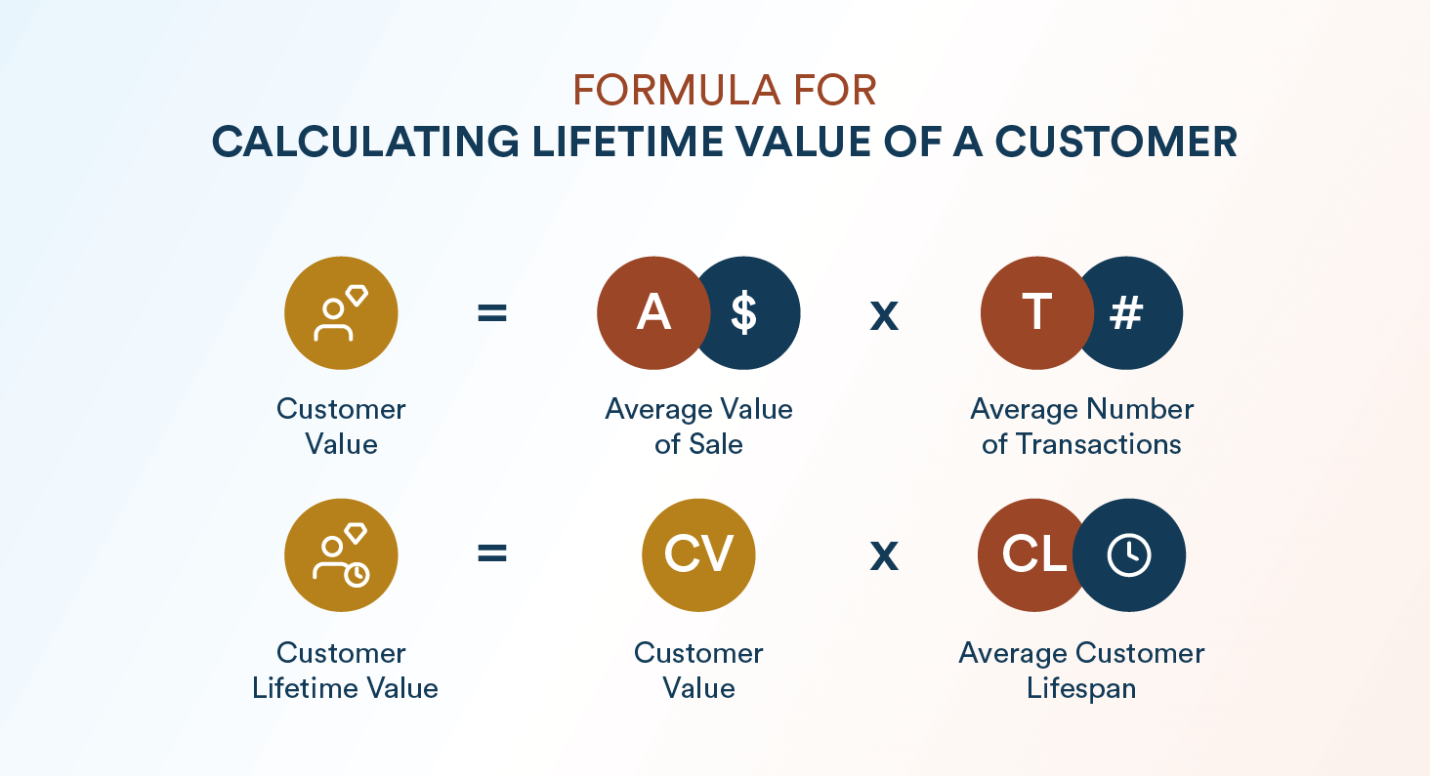
Noida Institute of Engineering and Technology, Greater Noida

Slide 4
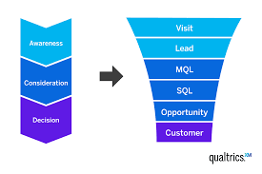
Noida Institute of Engineering and Technology, Greater Noida
New Customer Acquisition
The process of attracting and converting prospects into paying customers.
Methods include advertising, promotions, and referral programs.

Slide 5
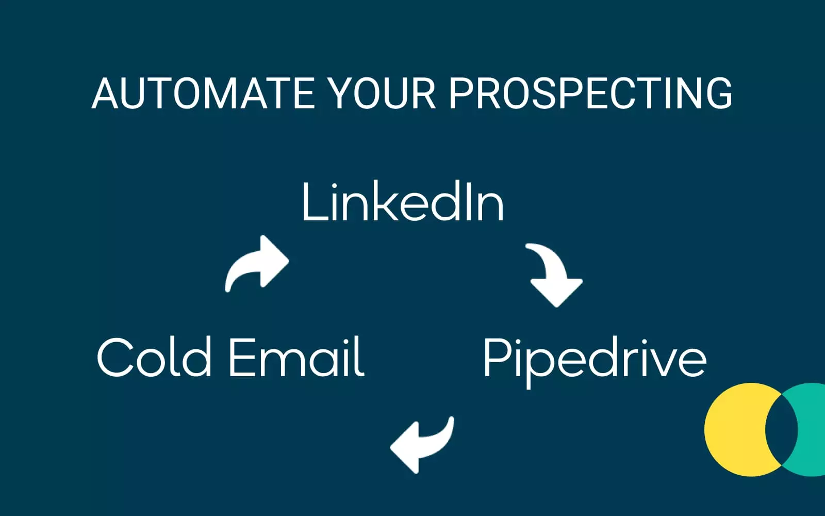
Noida Institute of Engineering and Technology, Greater Noida
Prospecting
Definition: Identifying and targeting potential customers who are likely to convert.
Tools : Customer data analytics.
Social media targeting.
CRM systems.

Slide 6
Noida Institute of Engineering and Technology, Greater Noida
Customer Acquisition Programs
Structured efforts to gain new customers through campaigns and offers.
Common programs:
Loyalty rewards for referrals.
Free trials or discounts for first-time customers.

Slide 7
Noida Institute of Engineering and Technology, Greater Noida
Tools for Customer Acquisition
Digital Tools: Google Ads, SEO, email marketing, and social media campaigns.
CRM Systems: Salesforce, HubSpot
Content Marketing: Blogs, videos, and webinars

Slide 8
Noida Institute of Engineering and Technology, Greater Noida
Managing Customer Lifecycle
1. Customer relation
Definition: Efforts to keep existing customers engaged and loyal.
Importance
Retaining customers is more cost-effective than acquiring new ones.
Boosts profitability through repeat business.

Slide 9
Noida Institute of Engineering and Technology, Greater Noida
Strategies for Customer Retention
Personalization: Tailored experiences and offers.
Loyalty Programs: Reward repeat purchases.
Customer Feedback: Use surveys to address concerns.
Regular Engagement: Email updates, exclusive deals.

Slide 10
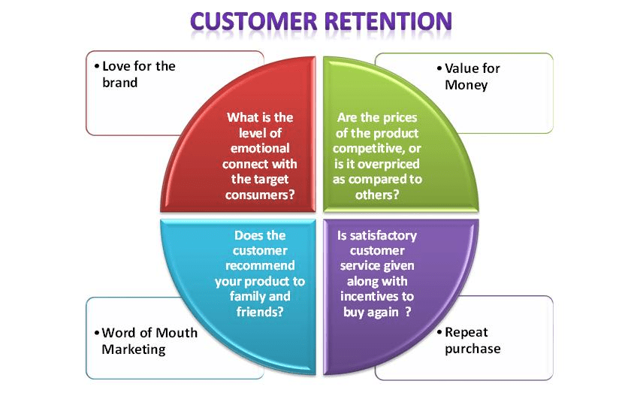

Slide 11
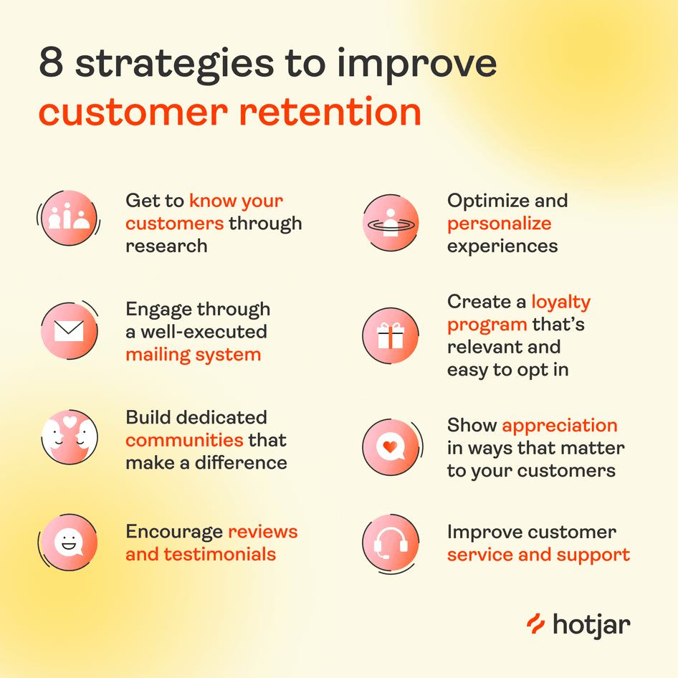

Slide 12
Noida Institute of Engineering and Technology, Greater Noida
Customer Satisfaction
Concept:
A measure of how products or services meet or exceed customer expectations.
Models of Customer Satisfaction:
Kano Model: Categorizes customer preferences into basic needs, performance needs, and excitement needs.
SERVQUAL Model: Focuses on service quality dimensions like reliability, assurance, tangibles, empathy, and responsiveness.
Rationale:
Satisfied customers are more likely to repurchase, recommend, and remain loyal.

Slide 13
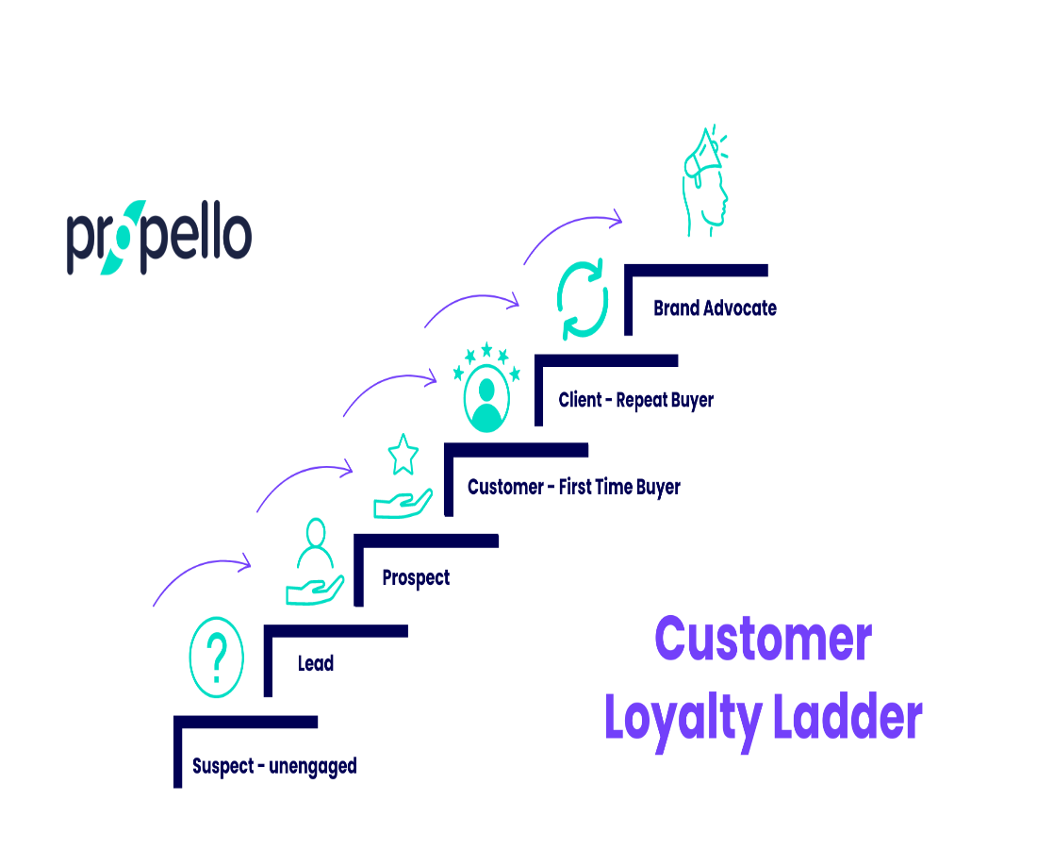
Noida Institute of Engineering and Technology, Greater Noida
Customer Loyalty Ladder:
Prospect: Potential customer.
Customer: First-time buyer.
Client: Repeat buyer.
Advocate: Recommends the brand.
Partner: Deep, emotional loyalty to the brand.

Slide 14
.
Noida Institute of Engineering and Technology, Greater Noida
Categories of Customer Loyalty
Transactional Loyalty: Based on rewards and convenience.
Emotional Loyalty: Strong attachment to the brand values and identity
Factors Affecting Customer Loyalty:
Product Quality: High-quality products/services.
Customer Service: Efficient and empathetic support.
Trust and Transparency: Honesty in business practices.
Convenience: Easy accessibility and usability

Slide 15
Noida Institute of Engineering and Technology, Greater Noida
MCQs
1. What does CLV stand for? a) Customer Link Value b) Customer Lifetime Value c) Customer Loyalty Value d) Customer Loss Value
3. What is the first step in prospecting? a) Closing the sale b) Identifying potential customers c) Providing customer service d) Conducting after-sales follow-up
2. Which of the following is NOT a component of CLV? a) Customer Lifespan b) Average Purchase Value c) Product Warranty Period d) Purchase Frequency
4. Which of the following is a common tool for customer acquisition? a) CRM Systems b) Employee Training c) Internal Auditing d) Tax Filing Software

Slide 16
Noida Institute of Engineering and Technology, Greater Noida
5. Customer acquisition programs are primarily focused on: a) Retaining existing customers b) Attracting and converting new customers c) Reducing marketing budgets d) Improving internal processes
7. Which of the following is an effective strategy for customer retention? a) Ignoring feedback b) Offering loyalty programs c) Increasing prices without notice d) Providing generic services
6. What is the primary goal of customer retention? a) Increase customer churn b) Reduce customer engagement c) Maintain long-term relationships with customers d) Eliminate marketing expenses
8. Customer retention is more cost-effective than customer acquisition because: a) Retained customers require less effort to satisfy b) Existing customers are more likely to make repeat purchases c) New customers always demand discounts d) Marketing to new customers is unnecessary

Slide 17
Noida Institute of Engineering and Technology, Greater Noida
9. Customer satisfaction is important because: a) It ensures higher product prices b) It leads to repeat purchases and brand loyalty c) It reduces the need for customer service d) It eliminates the need for marketing
10. Which model categorizes customer preferences into basic, performance, and excitement needs? a) SERVQUAL Model b) Kano Model c) Maslow’s Hierarchy d) Herzberg's Two-Factor Theory

Slide 18
Noida Institute of Engineering and Technology, Greater Noida
9. Customer satisfaction is important because: a) It ensures higher product prices b) It leads to repeat purchases and brand loyalty c) It reduces the need for customer service d) It eliminates the need for marketing
10. Which model categorizes customer preferences into basic, performance, and excitement needs? a) SERVQUAL Model b) Kano Model c) Maslow’s Hierarchy d) Herzberg's Two-Factor Theory

Slide 19

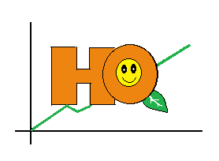
Thank You

